Slide 1
UBC Learning Analytics Hackathon: Improving student experience on Canvas discussion boards
Anas Muhammad, Alexander Hinton,
Sam Edwardes, Jarome Leslie

Slide 2
Problem
Canvas discussion boards are too cluttered and may be intimidating for students
Goal
Make the canvas discussion environment more user friendly and helpful for students
Encourage student participation on canvas in getting their questions asked

Slide 3

Demo

Slide 4
Next steps
Integrate recommendations into Canvas
Use Canvas course discussion data in testing
Compare the performance of alternative models
Additional feature:
Implementing tags on Canvas threads

Slide 5
APPENDIX

Slide 6
Product development process
Extracted thread data from Canvas API
Cleaned thread text to a model-ready form
Trained an inverse document frequency model using reddit data
Model compared student input to table of threads
Displays the most relevant threads

Slide 7
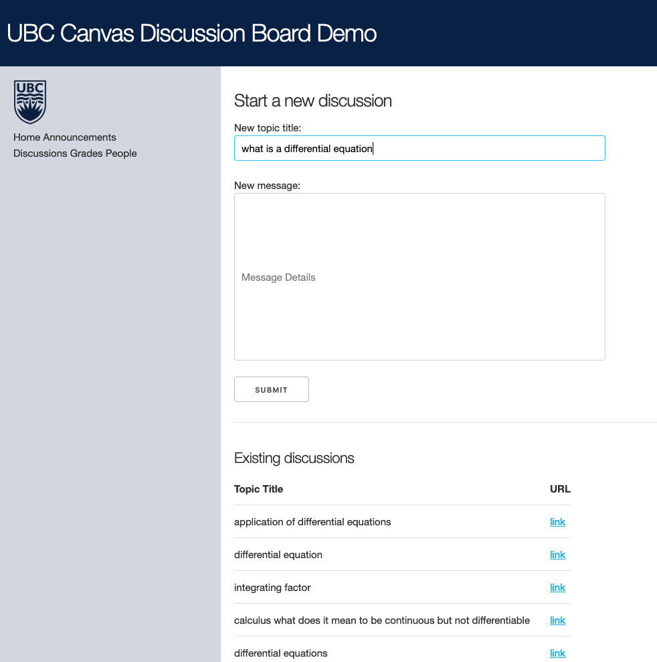
Sample output

